Slide 1
Web Application Security
CSC 481/681/781
Principles of Computer Security
Reference: Goodrich and Tamassia, Chapter 7
and OWASP Top 10

Slide 2
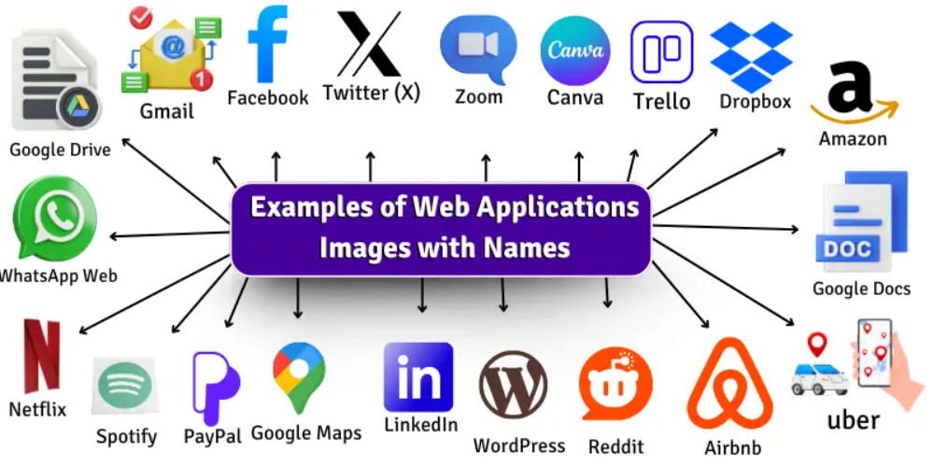
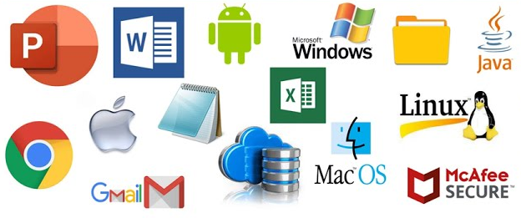
Web Applications
Web Application Security vs Software Security
Software
Web Applications
Protecting any kind of software from vulnerabilities and attacks; Often local or controlled; Environment is OS.
Protecting applications that run over the web (browser + server + HTTP). Environment is Internet.

Slide 3
Quick Survey...
Web Development depends on a lot of technologies
How many of you have experience/knowledge of:
HTTP?
HTML?
CSS?
JavaScript?
PHP?
SQL?

Slide 4
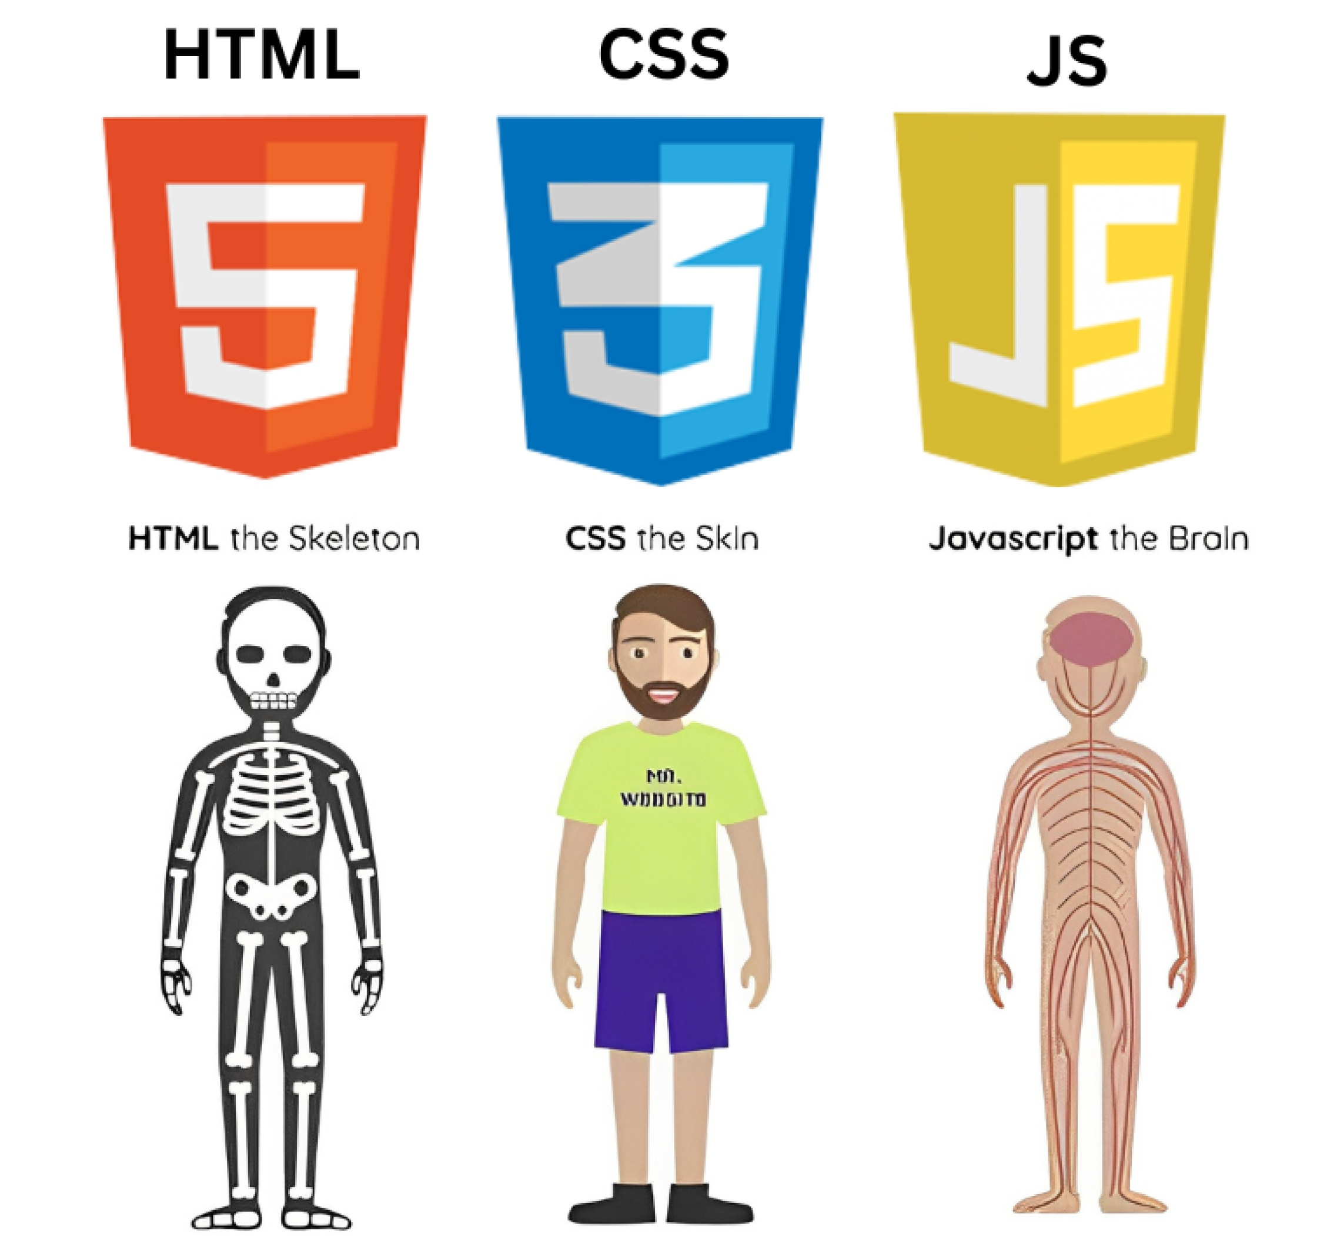
Quick Survey...
Web Development depends on a lot of technologies
How many of you have experience/knowledge of:
HTTP?
HTML?
CSS?
JavaScript?
PHP?
SQL?

Slide 5
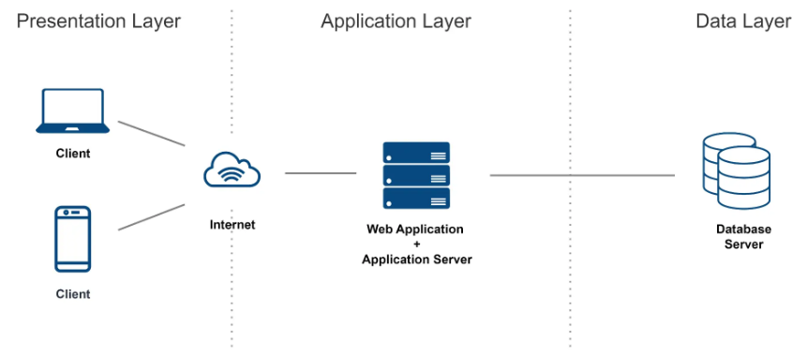
Web Applications Model
Web Development depends on a lot of technologies
HTTP/HTTPS
PHP
SQL
HTML/CSS/JavaScript

Slide 6
Web Applications Model
Web Development depends on a lot of technologies
HTTP/HTTPS
PHP
SQL
HTML/CSS/JavaScript
All these are languages that execute code - and all are locations of possible vulnerabilities and avenues of attack!

Slide 7
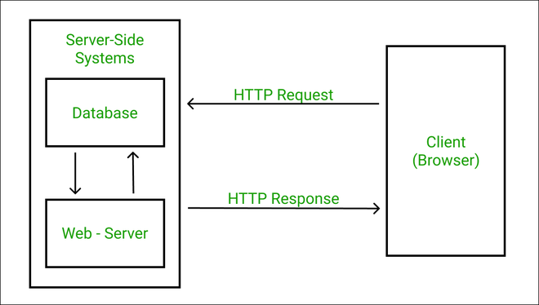
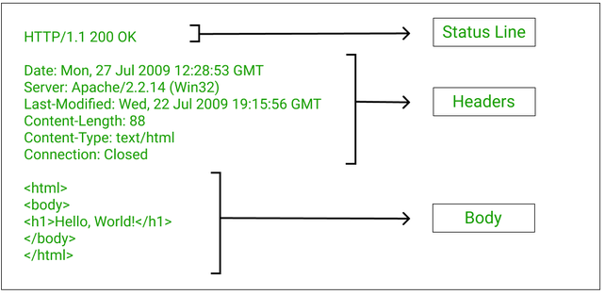
Application Layer Protocol - HTTP
Simplified Illustration
GET /index.html HTTP/1.0
At its core, HTTP is just a protocol for transferring data
Opening message has request and HTTP version

Slide 8
HTTP
Basics of HyperText Transfer Protocol - URLs
Global identifiers of network-retrievable documents
Example:
Special characters are encoded as hex:
%0A = newline
%20 or + = space, %2B = + (special exception)
http://www.uncg.edu:81/class?name=csc481#homework
Protocol
Fragment
Path
Query
Hostname
Port
https://www.w3schools.com/tags/ref_urlencode.ASP

Slide 9
HTTP - GET Request
Method
File
GET
parameters
HTTP version
Headers
GET /index.html?id=123 HTTP/1.1
Accept: image/gif, image/x-bitmap, image/jpeg, */*
Accept-Language: en
Connection: Keep-Alive
User-Agent: Mozilla/1.22 (compatible; MSIE 2.0; Windows 95)
Host: www.example.com
Referer: http://www.example.com/profiles.html
Blank line
Data – none for GET
GET : no side effect POST : possible side effect

Slide 10
HTTP - POST Request
Method
File
HTTP version
Headers
POST /sendform.php HTTP/1.1
Accept: image/gif, image/x-bitmap, image/jpeg, */*
Accept-Language: en
Connection: Keep-Alive
User-Agent: Mozilla/1.22 (compatible; MSIE 2.0; Windows 95)
Host: www.example.com
Referer: http://www.example.com/dataform.html
name=Steve&comment=Something+to+say
Data – POST parameters
GET : no side effect POST : possible side effect

Slide 11
HTTP - Response
HTTP version
Status code
Reason phrase
Headers
HTTP/1.0 200 OK
Date: Sun, 21 Apr 1996 02:20:42 GMT
Server: Microsoft-Internet-Information-Server/5.0
Connection: keep-alive
Content-Type: text/html
Last-Modified: Thu, 18 Apr 1996 17:39:05 GMT
Set-Cookie: …
Content-Length: 2543
<HTML> Some data... blah, blah, blah </HTML>
Data
Cookies

Slide 12
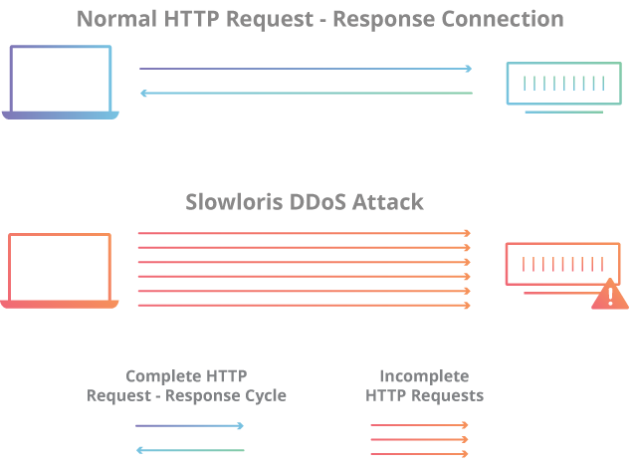
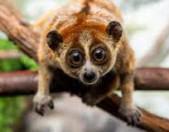
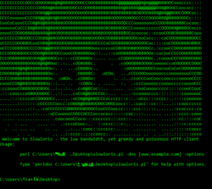
HTTP - Slow Loris Attack
Slowloris is a denial-of-service attack program which allows an attacker to overwhelm a targeted server by opening and maintaining many simultaneous HTTP connections between the attacker and the target.
Instead of flooding the server with traffic, the attacker slowly occupies all its connections so real users can’t connect.

Slide 13
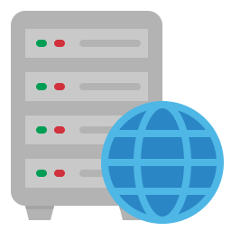

HTTP - Slow Loris Attack
Attacker: Conn1 → "GET / HTTP/1.1\r\n" Conn2 → "GET / HTTP/1.1\r\n" Conn3 → "GET / HTTP/1.1\r\n" ...
[Waiting...]

Slide 14
HTTP - Slow Loris Attack
I’m still here! I’m just slow, please wait for me.
[Almost timeout…]
Accept: image/gif \r\n
never finishes request, just keeps sending tiny updates

Slide 15


HTTP - Slow Loris Attack
Legitimate User
Cannot connect
[Waiting...][Waiting...][Waiting...][FULL]
Low bandwidth can still break servers!

Slide 16
Static HTTP Page Request
Relaying a file (no computed content)
GET /index.html HTTP/1.0
No database
No logic
Just file retrieval
index.html file
A static HTTP page request

Slide 17
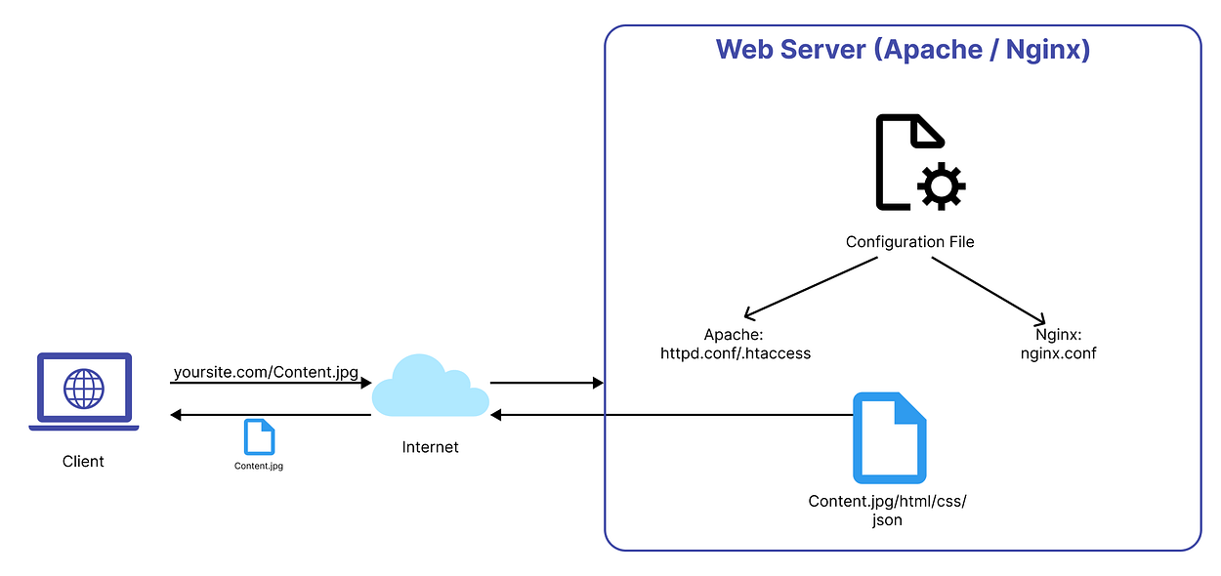
Static HTTP Page Request
Relaying a file (no computed content)

Slide 18
Static HTTP Page Request
Relaying a file (no computed content)
Web server configuration defines different ways to define the same things:
Where files are (DocumentRoot)
Which site is being served (VirtualHost)
Who can access what (permissions)
Apache web server configuration
Apache configuration defines parameters
Scope of definitions determined by HTML/XML-like tags
Microsoft IIS
Same concepts, but configured through GUI rather than file
Control Panel -> Administrative Tools -> Internet Services Manager
Define rules for a folder
Define a website
Define access restrictions

Slide 19
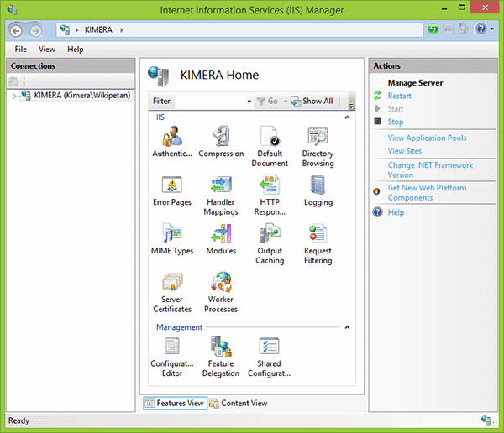
Static HTTP Page Request
Relaying a file (no computed content)

Slide 20
HTTP Server Security Issues
Overall goal: Set policy to restrict access
Issue 1: Restrict access to files published on web server
Server disallows things like http://example.com/../../etc/passwd
Called a “path traversal vulnerability”
Note: Microsoft IIS unicode bug hid path using alternate encodings
Example defining published files from Apache configuration:
Website files ✅ (safe to serve)
System files ❌ (must be protected)
# DocumentRoot: The directory out of which you will serve your
# documents. By default, all requests are taken from this directory, but
# symbolic links and aliases may be used to point to other locations.
#
DocumentRoot "/var/www/html"
A secure web server must strictly limit access to files inside the DocumentRoot and prevent users from escaping that directory.

Slide 21
HTTP Server Security Issues
Issue 2: Can restrict based on IP address
“deny from all” is fail-safe default policy (secure design principles)
Note: For internal documents, much safer to use a separate, firewalled internal server
Alias /pub/ /home/ftp/pub/
<Directory /home/ftp/pub>
order deny,allow
deny from all
allow from 129.120.0.0/255.255.0.0
allow from 10.1.0.0/255.255.0.0
Options Indexes FollowSymLinks
</Directory>

Slide 22
HTTP Server Security Issues
Issue 3: Can restrict based on user identity or authentication
Authentication part of HTTP protocol - seldom used though!
Usually custom-programmed with “session id” (more later)
Issue 4: Are local machine user ids “sensitive information”?
If so, be careful with enabling public_html!
http://example.com/~alice
Reveal ‘Alice is a valid user on this system.
Web servers must not only restrict which files are accessible, but also control who can access them and avoid leaking sensitive system information.

Slide 23

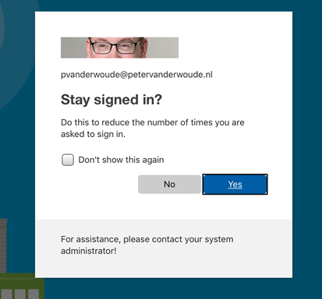
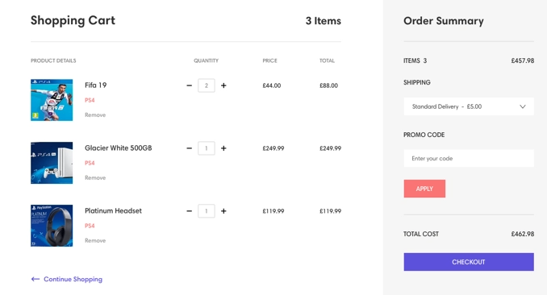
HTTP “State”
Cookies
Important: HTTP is stateless - protocol doesn’t “remember” anything from one request to the next.
HTTP: I don’t know if these are from the same user.
Request 1: GET /login Request 2: GET /dashboard
Without extra mechanisms:
No login persistence
No shopping cart

Slide 24
HTTP “State”
Cookies
Important: HTTP is stateless - protocol doesn’t “remember” anything from one request to the next.
To the rescue: Cookies
Server sends a small piece of named information to the browser
Browser sends that information back on subsequent requests
Sends when request is to a matching domain/path
Common use: Session ID
Secret cookie value relates request to specific session
Can use to reference session-specific variables on server
Example: “logged_in” flag (can’t store that in browser!)
Session IDs are unpredictable (random, large space)
If not, then susceptible to session hijacking
Must be protected from sniffing

Slide 25
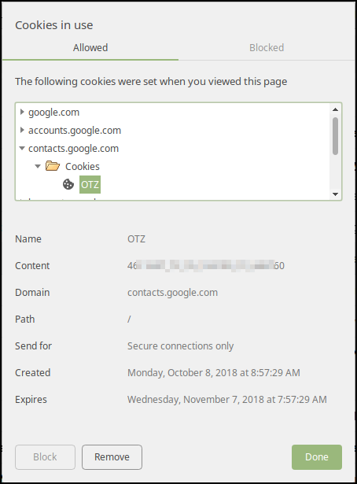
HTTP “State”
Cookies
Cookie Properties:
Name and content
Domain and path
To match with later requests
Secure flag
“Secure” cookies only sent over https
httpOnly flag
Not accessible by JavaScript
Expiration or max-age
Undefined → this session only
Check out some live cookies...

Slide 26
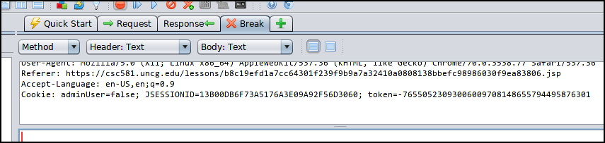
HTTP “State”
Cookies
One security concern: Never trust cookies from browser
Actual rule is: Never trust any data from browser
Malicious clients can send fake or modified cookies
Don’t trust input validation
Don’t trust “uneditable” hidden form fields
Don’t trust that URLs aren’t tampered with
…
OWASP Zed Attack Proxy:
Can view - and edit - cookies as they are sent

Slide 27
HTTP “State”
Cookies
Session Hijacking (Demo)
https://www.youtube.com/watch?v=eDui1JX49zc
Notes:
4:55

Slide 28
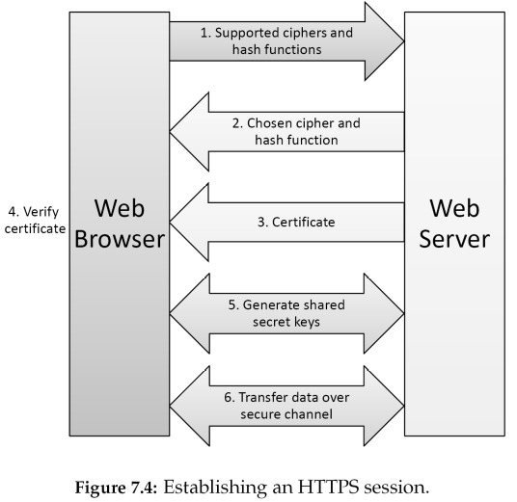
Protecting HTTP using HTTPS
Confidentiality and Integrity protections with SSL/TLS
Protecting from 3rd parties (eavesdroppers and man-in-the-middle attacks)
Step 1: Crypto algorithms can be updated or removed
Protocol protected against algorithm breaks
Step 3: Recall certificates from crypto overview
Know who you’re talking to
Step 5: Session key generation
Authenticate w/cert pubkey
Step 6: Data is encrypted and includes MAC
Confidentiality and integrity

Slide 29
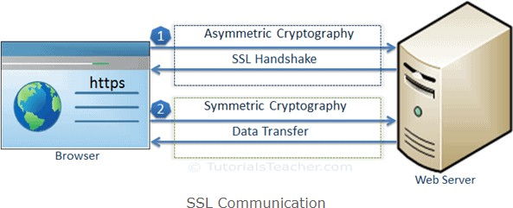
Protecting HTTP using HTTPS
Confidentiality and Integrity protections with SSL/TLS
HTTPS established an encrypted link between the browser and the web server using the Secure Socket Layer (SSL) or Transport Layer Security (TLS) protocols
SSL fundamentally works with Asymmetric and Symmetric Cryptography Protocols.
SSL handshake is an asymmetric cryptography which allows the browser to verify the web server, get the public key and establish a secure connection
Both the client and the server have a valid session key which they will use to encrypt or decrypt actual data.
Important: HTTPS protects data in transit, does not protect server and browser vulnerabilities

Slide 30
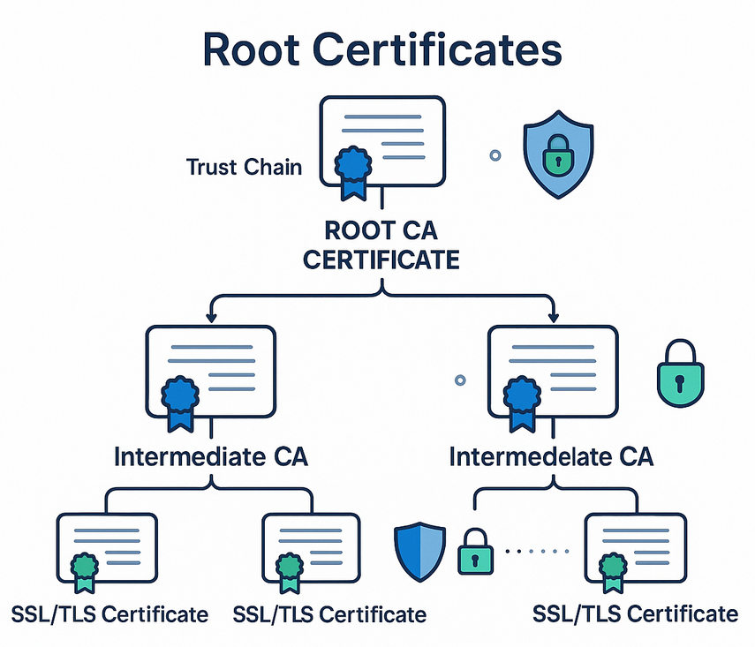
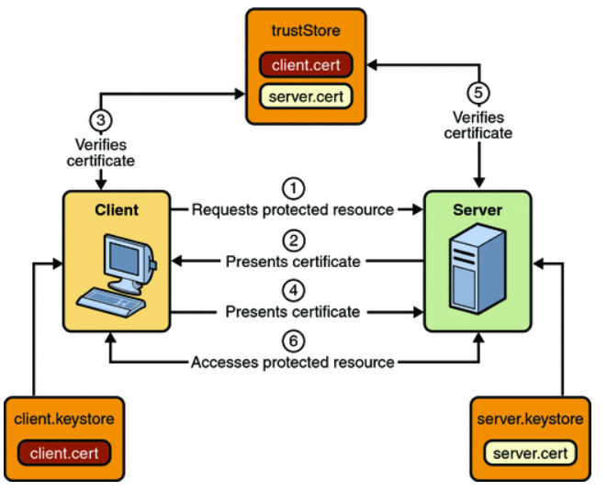
Protecting HTTP using HTTPS
Confidentiality and Integrity protections with SSL/TLS
HTTPS established an encrypted link between the browser and the web server using the Secure Socket Layer (SSL) or Transport Layer Security (TLS) protocols

